Slide 1


Visual Enhancement Technique For Underwater Images

Slide 2


AGENDA
Introduction
Problem Statement
Literature Review
Methodology & Block Diagram
Implementation
Experimental Results
Challenges
Applications and Future Scope
Conclusion
References
2

Slide 3

Introduction
The underwater environment poses unique challenges due to the physical properties of water.
Light attenuation causes a loss of colors, with red, orange, and yellow wavelengths being absorbed quickly, leading to a blue-green color cast.
Scattering occurs due to particles in water, causing images to lose sharpness and clarity.
Image enhancement of underwater images is important in cases where the image is to be used in marine biology, underwater exploration, or underwater photography.
Improvement of the imagery contrast and sharpness is critical for visualization of the scene, further analysis and making decision in underwater conditions.
3

Slide 4
Problem Statement
Underwater photographs are usually dark and have poor contrast, mainly due to inadequate illumination.
Blue and green saturation is enhanced making the pictorial scene look artificial.
Floating particles interfere with the light and result in poor image resolution.
Improve the quality of underwater images using MATLAB with the help of Bidimensional Empirical Mode Decomposition (BEMD).
The objective is to enhance image sharpening, contrast, and color to natural components of the images and make images more interpretative in underwater contexts.
4

Slide 5
Literature Review
The literature discloses vast work done for improving the underwater image quality including the scattering and color distortion.
Adaptive Histogram Equalization (AHE) and white balancing help in good color correction but are comparatively less good at handling strong deep water images.
Study/Technique | Methodology | Strengths | Limitations
Adaptive Histogram Equalization | Enhances contrast | Simple to apply | Adds noise
White Balancing | Color correction | Effective in shallow | Less effective in deep water
5

Slide 6
Literature Review...
Fusion-based approaches and machine learning techniques have however been developed and demonstrated to be effective but these methods have not been easily applied in real-time operation.
A common drawback of most methods is that they do not consider scattering and blurring collectively, and address them separately.
That is why this project continues these methods and applies Bidirectional empirical mode decomposition (BEMD), due to which we obtain a clear image, avoiding the noise problem, and it is more adjusted to various sea conditions.
6

Slide 7
Methodology
Bidirectional Empirical Mode Decomposition (BEMD) is an improved image decomposition technique optimized for application in nonlinear and nonstationary data forms.
It analyzes an image into Intrinsic Mode Functions (IMFs) and residues which denote different frequencies.
BEMD is used in the method of the enhanced underwater image by separate manipulation of high and low-frequency details facilitating correction of scattering and blurring effects.
This bidirectional characteristic of the decomposition makes it possible to capture variations realistically, along the horizontal as well as the vertical feature planes characteristic of underwater images.
7

Slide 8
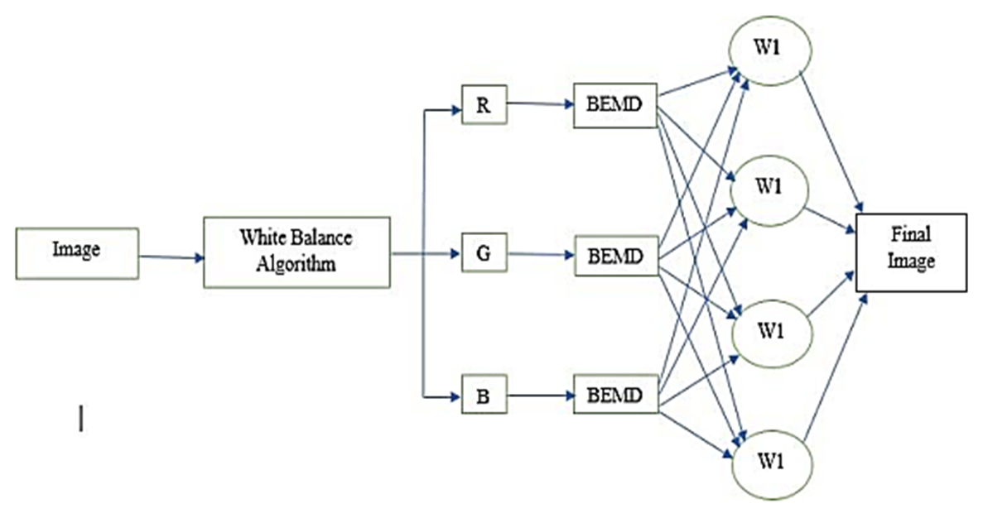
Block Diagram
8

Slide 9
Implementation
The implementation of BEMD in MATLAB involves the following steps:
Step 1: Image Acquisition: Acquire the underwater images with a different level of degradation. Make certain the resource you will use for testing will cover many and various possibilities.
Step 2: White Balancing: Choose and use an adequate algorithm for white balancing adjustment, such as Gray World or Perfect Reflector.
Step 3: BEMD Decomposition: From the image computing, extract Intrinsic Mode Functions (IMFs) and a residue through the BEMD process. IMFs are high-frequency details while the residue encompasses low-frequency information.
Step 4: Sub-band Processing: Perform color compensation immediately on the red and blue channels of IMFs and on the residue by using color transfer and histogram equalization.
9

Slide 10
Implementation...
Step 5: In this second level of white balance, the user can select a proper mood or preserve the color tones of the previous photo shot. Particularly, adjust the green color correction in order to enhance color balance even more.
Step 6: Image Reconstruction: The enhanced image is obtained from the merging of the processed IMFs and the residue.
Step 7: Performance Evaluation: Quantitatively evaluate on average the quality of the boosted pictures concerning the initial distorted ones using PSNR, SSIM, and RMSE. Emulation of qualitative assessment on the improved image quality by use of subjective judged by the human eye.
10

Slide 11
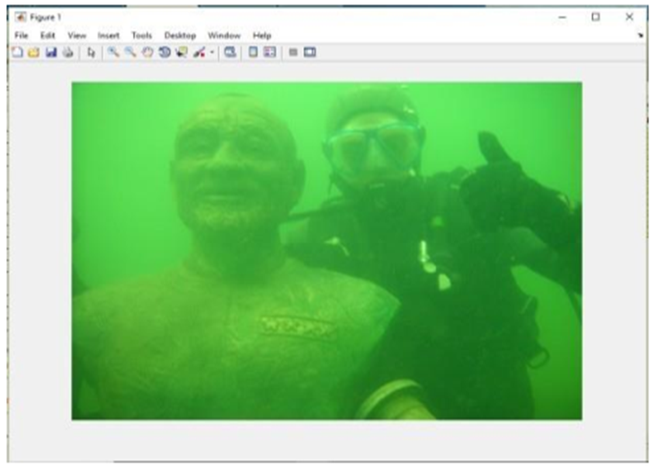
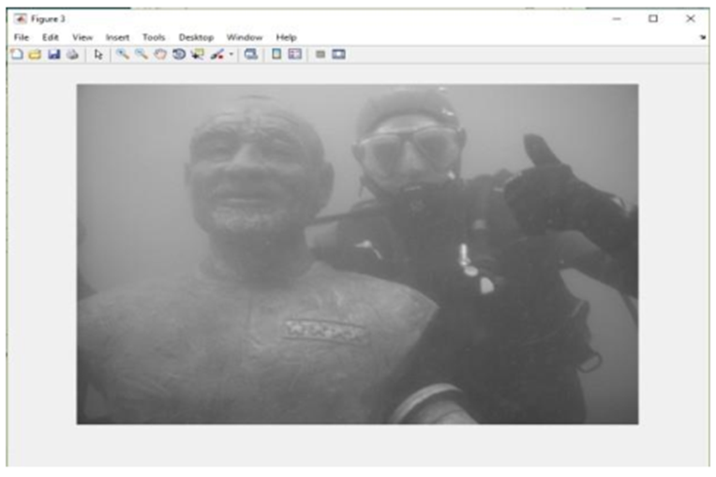
Expected Result
Step 1: Give Input Image
Step 2: Apply Gray Scaling for White balancing
11

Slide 12
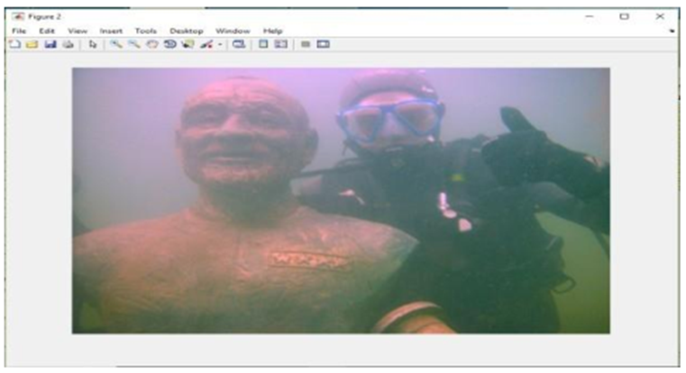
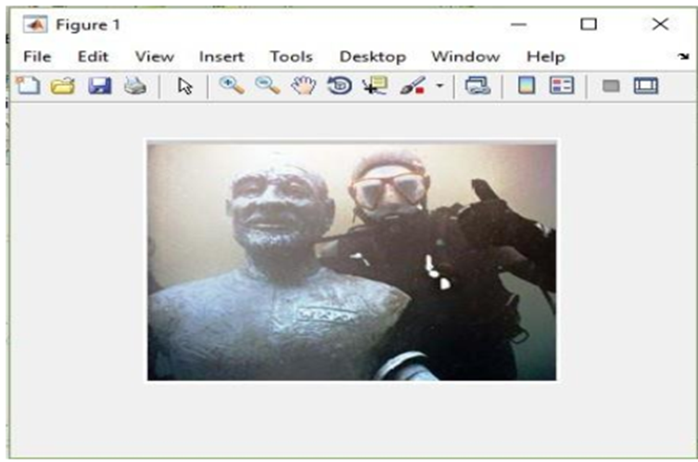
Expected Result
Step 3: White Balancing
Step 4: Image after BEMD
12

Slide 13
Expected Result
Step 3: White Balancing
Step 4: Image after applying BEMD
13

Slide 14
Implementation
Bidirectional Empirical Mode Decomposition (BEMD) is an improved image decomposition technique optimized for application in nonlinear and nonstationary data forms.
It analyzes an image into Intrinsic Mode Functions (IMFs) and residues which denote different frequencies.
BEMD is used in the method of the enhanced underwater image by separate manipulation of high and low-frequency details facilitating correction of scattering and blurring effects.
This bidirectional characteristic of the decomposition makes it possible to capture variations realistically, along the horizontal as well as the vertical feature planes characteristic of underwater images.
14

Slide 15
Challenges
Computational Complexity: BEMD consumes a lot of computational time particularly when handling large images.
Mode Mixing: A combination of different frequencies may be wrong, hampering image details.
Handling Large-Scale Data: Large images burden memory and computational power because of their detailed data.
Parameter Sensitivity: When the parameters are set wrongly; it implies to say that the decomposition and enhancement will also be very low.
15

Slide 16
Applications
Marine Exploration: Improves marine-related images for observing marine organisms and their environment.
Military Surveillance: Enhances image resolution for surveillance in water, and warfare strategies.
Environmental Monitoring: For surveillance and observation of the extension of pollution and alterations of aquatic habitats, it dramatically boosts the images.
Future Scopre
Real-Time Video Processing: Using BEMD in real-time underwater video data for changing scene improvement.
Noise and Blur Reduction: Combined analysis of BEMD with other methods to gain additional degrees of suppressing underwater noise and blurring.
Machine Learning Integration: Integrating AI to extend BEMD parameters by increasing desirable image enhancement results.
15

Slide 17
Conlusion
In the field of image processing, there are several novel techniques are proposed to enhance the visual quality of underwater images.
Existing techniques improve the deep water images to a large extent. However, all these methods suffer from some poor-quality metrics. A good quality image will have high PSNR and low MSE.
Based on these characteristics the proposed method and the conventional method are compared.
The results show that among both techniques, White Balanced BEMD gives the better enhancement of quality parameters for underwater images.
16

Slide 18
References
[1] Padmavathi, G., et al. "Comparison of filters used for underwater image preprocessing." International Journal of Computer Science and Network Security10.1 (2010): 58-65.
[2] Balvant Singh, Ravi Shankar Mishra, Puran Gour, “Analysis of contrast enhancement techniques for underwater image” International Journal - of computer technology and Electronics Engineering (IJCTEE) Volume 1, issue 2, pp: 190-195
[3] Ritu Singh, Dr. Mantosh Biswas, “Adaptive histogram equalization based fusion Technique for hazy underwater image enhancement” IEEE International Conference on computational intelligence and Computing Research, 2016, pp: 1-5
[4] Sonam Bharal, “Review of underwater image enhancement techniques”, International Research Journal of Engineering and Technology (IRJET), and Volume: 02 Issue: 03, June 2015, pp: 340-344.
[5] Sudhansu Mallik, Salman S. Khan, Umesh C. Pati, “Visual Enhancement of Underwater Image by White-Balanced EMD”, 8th International Conference on Computing, Communication and Networking Technologies (ICCCNT) -2017, pp: 1-6.
17

Slide 19

Thank you
for listening

